Slide 1


Macroeconomics
Ninth Edition
Chapter 4
Economic Efficiency, Government Price Setting, and Taxes
Copyright © 2025, 2021, 2018 Pearson Education, Inc. All Rights Reserved
Notes:
If this PowerPoint presentation contains mathematical equations, you may need to check that your computer has the following installed:
1) MathType Plugin
2) Math Player (free versions available)
3) NVDA Reader (free versions available)

Slide 2
Chapter Outline
4.1 Consumer Surplus and Producer Surplus
4.2 The Efficiency of Competitive Markets
4.3 Government Intervention in the Market: Price Floors and Price Ceilings
4.4 The Economic Effect of Taxes
Appendix: Quantitative Demand and Supply Analysis

Slide 3

What Do Food Riots in Venezuela and the Rise of Uber in the United States Have in Common?
25 years ago, Venezuelans enjoyed the highest standard of living in Latin America; but by 2017, 90% lived in poverty, and people fought over food supplies.
In many U.S. cities, operating a taxi requires a permit from the city government; but ride-sharing apps Uber and Lyft disrupted the taxi market, decreasing the value of these permits.
What do these two situations have in common? Both situations involve governments trying to alter prices.

Slide 4
4.1 Consumer Surplus and Producer Surplus
Distinguish between the concepts of consumer surplus and producer surplus.
Surplus (noun): Something that remains above what is used or needed.
Economists use the idea of “surplus” to refer to the benefit that people derive from engaging in market transactions.
Consumer surplus is the difference between the highest price a consumer is willing to pay for a good or service and the actual price the consumer pays.
Producer surplus is the difference between the lowest price a firm would be willing to accept for a good or service and the price it actually receives.

Slide 5
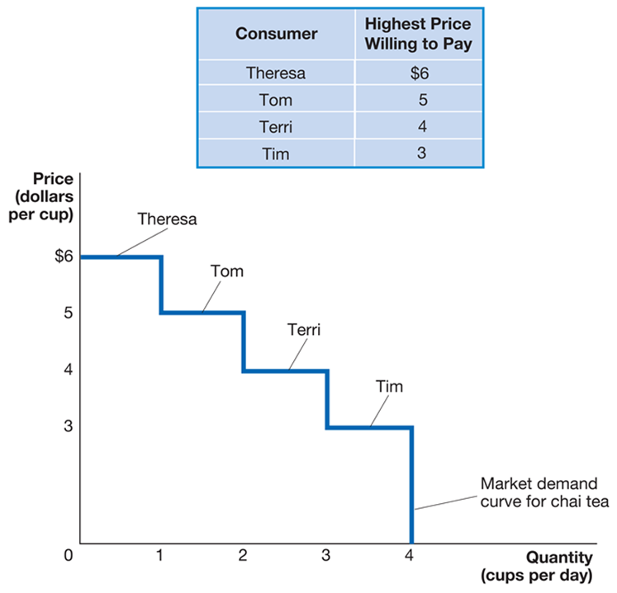
Figure 4.1 Deriving the Demand Curve for Chai Tea (1 of 2)
Suppose four people are each interested in buying a cup of chai tea.
We can characterize them by the highest price they are willing to pay.
At prices above $6, no chai tea will be sold.
At $6, one cup will be sold, etc.
Notes:
The table has 4 rows and 2 columns. The columns have the following headings from left to right: Consumer and Highest price willing to pay. The row entries are as follows: Row 1. Consumer, Theresa. Highest price willing to pay, 6. Row 2. Consumer, Tom. Highest price willing to pay, 5. Row 3. Consumer, Terri. Highest price willing to pay, 4. Row 4. Consumer, Tim. Highest price willing to pay, 3.
On the graph, the X-axis represents quantity in cups per day, and the Y-axis represents price in dollars per cup. The market demand curve for chai tea falls through the graph from Theresa at 6, stair stepping down to Tom at 5, Terri at 4, and Tim at 3, before falling to 4 on the X-axis.

Slide 6
Figure 4.1 Deriving the Demand Curve for Chai Tea (2 of 2)
How much benefit do the potential tea consumers derive from this market?
That depends on the price and their marginal benefit, the additional benefit to a consumer from consuming one more unit of a good or service.
If the price is low, many of the consumers benefit.
If the price is high, few (if any) of the consumers benefit.
Notes:
The table has 4 rows and 2 columns. The columns have the following headings from left to right: Consumer and Highest price willing to pay. The row entries are as follows. Row 1. Consumer, Theresa. Highest price willing to pay, 6. Row 2. Consumer, Tom. Highest price willing to pay, 5. Row 3. Consumer, Terri. Highest price willing to pay, 4. Row 4. Consumer, Tim. Highest price willing to pay, 3.
On the graph, the X-axis represents quantity in cups per day, and the Y-axis represents price in dollars per cup. The market demand curve for chai tea falls through the graph from Theresa at 6, stair stepping down to Tom at 5, Terri at 4, and Tim at 3, before falling to 4 on the X-axis.

Slide 7
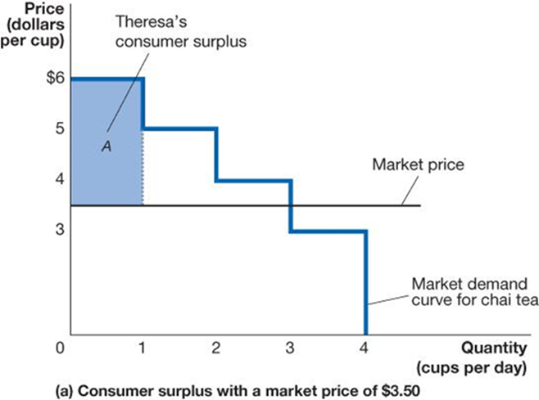
Figure 4.2 Measuring Consumer Surplus (1 of 3)
If the price of tea is $3.50 per cup, Theresa, Tom, and Terri will buy a cup.
Theresa was willing to pay $6.00; a cup of chai tea is “worth” $6.00 to her. She gets it for $3.50, so she derives a net benefit of
Area A represents this net benefit and is known as Theresa’s consumer surplus in the chai tea market.
Notice that the area A is
Notes:
In panel (a), the consumer surplus with a market price of 3.50 dollars is represented on the x y plane. The quantity in cups per day is plotted versus the price in dollars per cup. A horizontal line at y = 3.5 represents the market price. The market demand curve for chai tea starts at (0, 6) and extends to (1, 6). The area between this part of the curve and the market price line is a shaded box A, which represents Theresa's consumer surplus. The market demand curve continues to step down to the right, with the next point at (1, 5), then (2, 5), followed by (2, 4) and (3, 4) and continuing this trend until it ends at (4, 0).

Slide 8
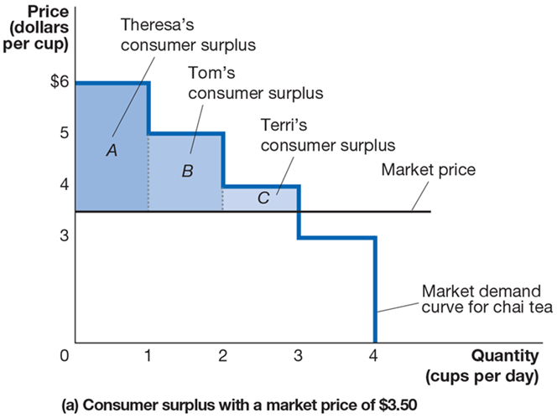
Figure 4.2 Measuring Consumer Surplus (2 of 3)
Tom and Terri also obtained consumer surplus, equal to $1.50 (area B) and $0.50 (area C).
The sum of the areas of rectangles A, B, and C is the consumer surplus in the chai tea market.
This area can be described as the area below the demand curve, above the price that consumers pay.
Notes:
Panel (a) depicts the consumer surplus with a market price of $3.50. The X-axis represents quantity in cups per day, and the Y-axis represents price per dollars per cup. A horizontal line across the graph at 3.5 represents the market price. The market demand curve for chai tea stair steps down the graph. The area between $6 and 3.5 is A, and makes up Theresa’s consumer surplus. The area between 5 and 3.5 is B, and makes up Tom’s consumer surplus. The area between 4 and 3.5 is C, and makes up Terri’s consumer surplus.

Slide 9
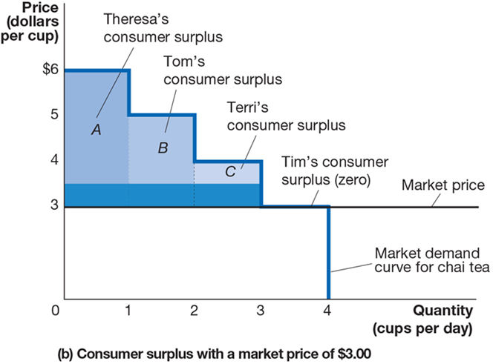
Figure 4.2 Measuring Consumer Surplus (3 of 3)
If the price falls to $3.00, Theresa, Tom, and Terri each gain an additional $0.50 of consumer surplus.
Tim is indifferent between buying the cup and not; his well-being is the same either way.
The overall consumer surplus remains the area below the demand curve, above the (new) price.
Notes:
Panel (b) depicts the consumer surplus with a market price of $3.00. The X-axis represents quantity in cups per day, and the Y-axis represents price per dollars per cup. A horizontal line across the graph at 3.5 represents the market price. The market demand curve for chai tea stair steps down the graph. The area between $6 and 3 is A, and makes up Theresa’s consumer surplus. The area between 5 and 3 is B, and makes up Tom’s consumer surplus. The area between 4 and 3 is C, and makes up Terri’s consumer surplus. Tim’s consumer surplus is at 0. The margin between 3 and 3.5 is highlighted.

Slide 10
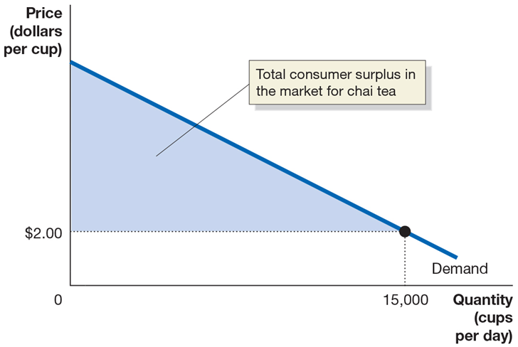
Figure 4.3 Total Consumer Surplus in the Market for Chai Tea
The market for chai tea is larger than just our four consumers.
With many consumers, the market demand curve looks like “normal”: a straight line.
Consumer surplus in this market is defined in just the same way: the area below the demand curve, above price. The graph shows the total consumer surplus if the price is $2.00.
Notes:
The X-axis represents quantity in cups per day, and the Y-axis represents price per dollars per cup. The demand curve falls through the graph through the point (15,000, 2). The area between the demand curve and $2.00 to the point of 15,000 is shaded, making a right triangle that represents the total consumer surplus in the market for chai tea.

Slide 11
Apply the Concept: The Consumer Surplus from Uber (1 of 2)
Access to ride-sharing services from Uber is beneficial for consumers.
We can measure just how beneficial it is by estimating the consumer surplus derived in the market.
What would we need to know in order to do this?
The demand curve for Uber’s services
The price of Uber’s services

Slide 12
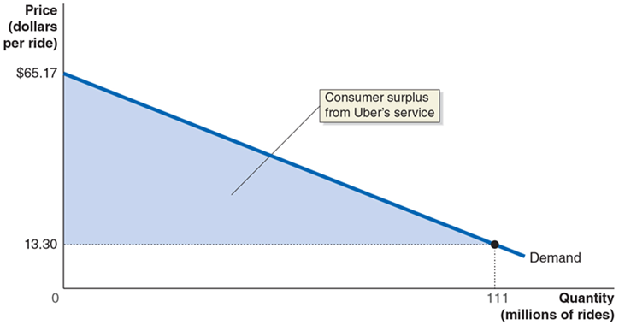
Apply the Concept: The Consumer Surplus from Uber (2 of 2)
Five economists analyzed 6 months of Uber rides in New York, San Francisco, Chicago, and Los Angeles in 2015 to estimate the demand curve for Uber rides.
111 million rides were taken, with an average price of $13.30.
Notes:
The X-axis represents quantity in millions of rides, and the Y-axis represents price in dollars per ride. The demand curve falls through the graph through the point (111, 13.30). The area between the demand curve and 13.30 to the point of 111 is shaded, making a right triangle that represents the consumer surplus from Uber’s service.

Slide 13
Producer Surplus
Producer surplus can be thought of in much the same way as consumer surplus.
It is the difference between the lowest price a firm would accept for a good or service and the price it actually receives.
What is the lowest price a firm would accept for a good or service?
The marginal cost of producing that good or service.
Marginal cost: The change in a firm’s total cost from producing one more unit of a good or service.

Slide 14
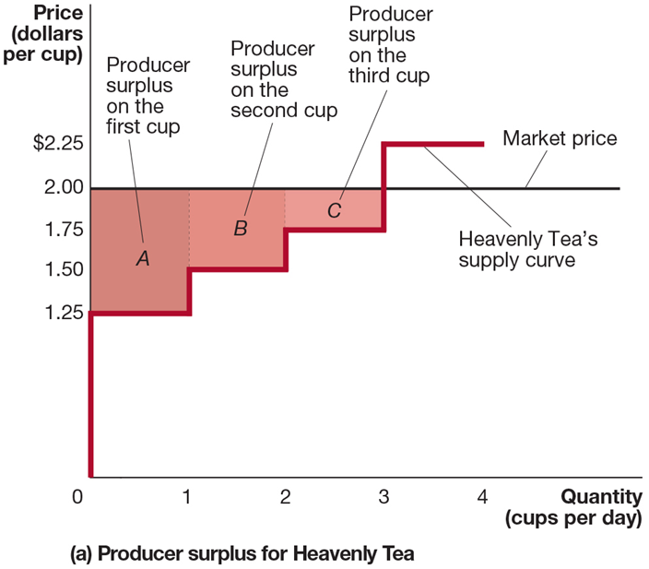
Figure 4.4 Measuring Producer Surplus (1 of 2)
Heavenly Tea is a (very small) producer of chai tea.
When the market price of tea is $2.00, Heavenly Tea receives a producer surplus of $0.75 on the first cup (the area of rectangle A), $0.50 on the second cup (rectangle B), and $0.25 on the third cup (rectangle C).
Notes:
Panel (a) depicts the producer surplus for Heavenly Tea. The X-axis represents quantity in cups per day, and the Y-axis represents price per dollars per cup. A horizontal line across the graph at 2 represents the market price. The Heavenly Tea supply curve stair steps up the graph. The area between 1.25 and 2 is A and makes up producer surplus on the first cup. The area between 1.50 and 2 is B and makes up producer surplus on the second cup. The area between 1.75 and 2 makes up C, producer surplus on the third cup.

Slide 15
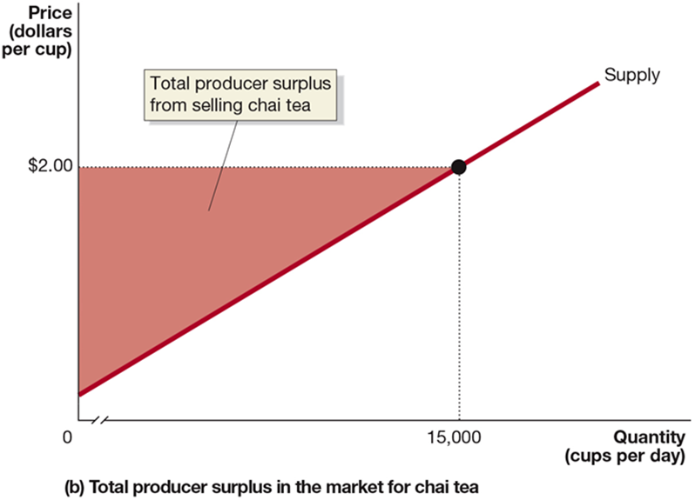
Figure 4.4 Measuring Producer Surplus (2 of 2)
The total amount of producer surplus tea sellers receive from selling chai tea can be calculated by adding up the individual producer surplus received on every cup sold.
Total producer surplus is equal to the area above the supply curve and below the market price of $2.00.
Notes:
Panel (b) depicts the total producer surplus in the market for chai tea. The truncated X-axis represents quantity in cups per day, and the Y-axis represents price per dollars per cup. The supply curve rises through the graph, and point (15,000, 2). The area between the supply curve, (0, 2), and (15,000, 2) is shaded, forming a right triangle that represents the total producer surplus from selling chai tea.

Slide 16
What Do Consumer Surplus and Producer Surplus Measure?
Consumer surplus measures the net benefit to consumers from participating in a market rather than the total benefit.
Consumer surplus in a market is equal to the total benefit received by consumers (measured in dollars) minus the total amount they must pay to buy the good or service.
Similarly, producer surplus measures the net benefit received by producers from participating in a market.
Producer surplus in a market is equal to the total amount firms receive from consumers minus the cost of providing the good or service.

Slide 17
4.2 The Efficiency of Competitive Markets
Explain the concept of economic efficiency.
We can think about efficiency in a market in two ways:
A market is efficient if all trades take place where the marginal benefit exceeds the marginal cost, and no other trades take place.
A market is efficient if it maximizes the sum of consumer surplus and producer surplus (i.e., the total net benefit to consumers and firms), known as the economic surplus.

Slide 18
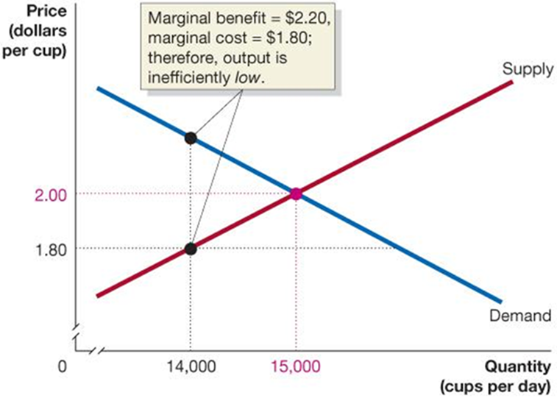
Figure 4.5 Marginal Benefit Equals Marginal Cost Only at the Competitive Equilibrium (1 of 2)
Recall that the demand curve describes the marginal benefit of each additional cup of tea, while the supply curve describes the marginal cost of each additional cup of tea.
If the quantity is too low, the value to consumers of the next unit exceeds the cost to producers.
Notes:
The quantity of cups per day is plotted versus the price in dollars per cup. The x-axis has a break between 0 and the lowest value, which is 14,000. The y-axis has a break between 0 and the lowest value, which is 1.80. The supply curve starts at (1,000, 1) and rises to the right. The demand curve starts at (1,000, 5) and falls to the bottom right corner of the graph. The supply and demand curves intersect at the point (15,000, 2). A point on the supply curve at (14,000, 1.8) connects to a line on the demand curve at (14,000, 2.2). An inset text box states, marginal benefit = 2.20 dollars. Marginal cost = 1.80 dollars, therefore output is inefficiently low. All numbers are approximate.

Slide 19
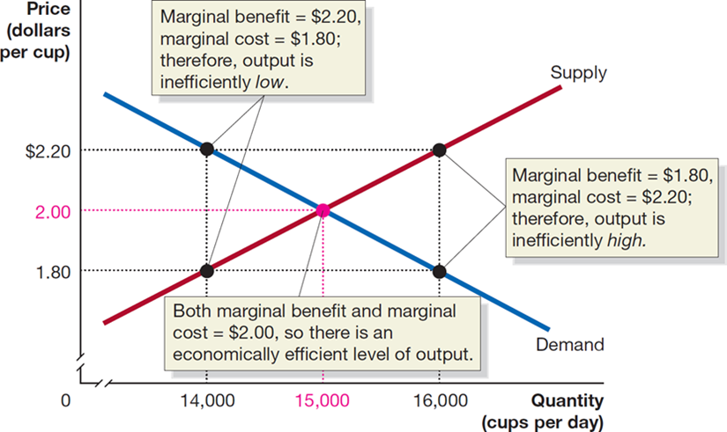
Figure 4.5 Marginal Benefit Equals Marginal Cost Only at the Competitive Equilibrium (2 of 2)
If the quantity is too high, the cost to producers of the last unit is greater than the value consumers derive from it.
Only at the competitive equilibrium is the last unit valued by consumers and producers equally—economic efficiency.
Notes:
On the truncated graph, the X-axis represents quantity in cups per day, and the Y-axis represents price per dollars per cup. The supply curve rises through the graph at (14,000, 1.80), (15,000, 2), and (16,000, 2.20). The demand curve falls through the points (14,000, 2.20), (15,000, 2), and (16,000, 1.80). The curves intersect at (15,000, 2). Both marginal benefit and marginal cost = $2.00, so there is an economically efficient level of output. Points (14,000, 1.80) and (14,000, 2.20) have a marginal benefit = to $2.20, and marginal cost = to $1.80. Therefore, output is inefficiently low. Points (16,000, 1.80) and (16,000, 2.20) have marginal benefit = to $1.80 and marginal cost = $2.20, Therefore, output is inefficiently high.

Slide 20
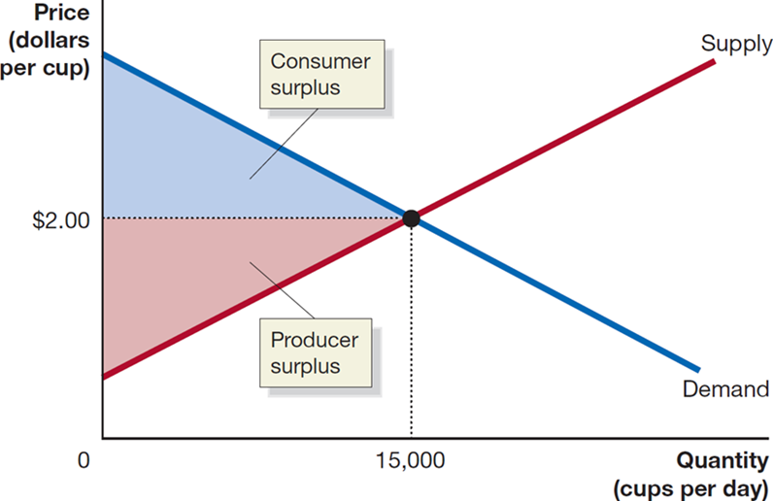
Figure 4.6 Economic Surplus Equals the Sum of Consumer Surplus and Producer Surplus
The figure shows the economic surplus (the sum of consumer surplus and producer surplus) in the market for chai tea.
At the competitive equilibrium quantity, the economic surplus is maximized.
Our two concepts of economic efficiency result in the same level of output!
Notes:
The X-axis represents quantity in cups per day, and the Y-axis represents price in dollars per cup. The demand curve falls through the graph, the supply curve rises through the graph, and they intersect at (15,000, 2). The triangular area between (0, 2), (15,000, 2), and the supply curve is shaded red and represents the producer surplus. The triangular area between (0, 2), (15,000, 2), and the demand curves is shaded blue and represents the consumer surplus.

Slide 21
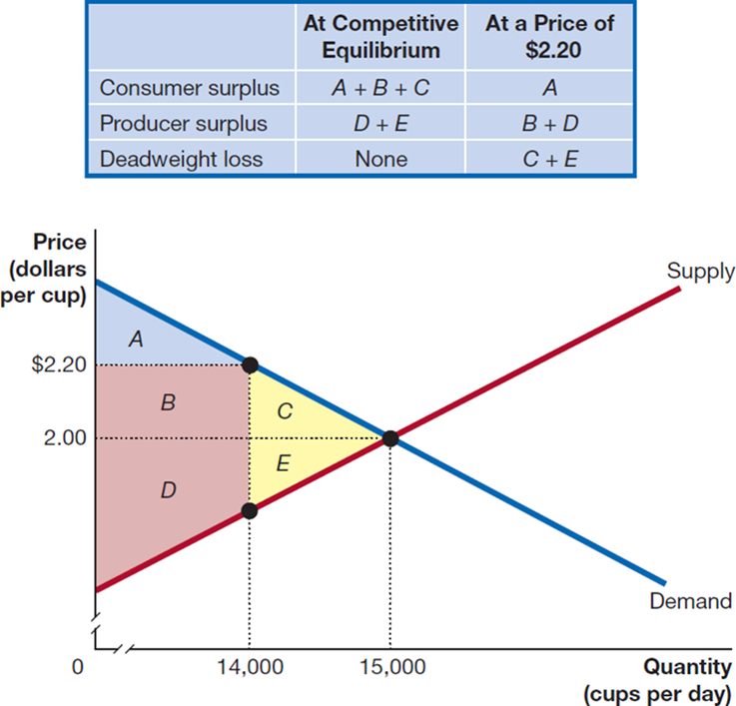
Figure 4.7 When a Market Is Not in Equilibrium, There Is a Deadweight Loss (1 of 2)
When the price of chai tea is $2.20 instead of $2.00, consumer surplus declines from an amount equal to the sum of areas A, B, and C to just area A.
Producer surplus increases from the sum of areas D and E to the sum of areas B and D.
Economic surplus decreases by the sum of areas C and E.
Notes:
The table has 3 rows and 2 columns. The columns have the following headings from left to right: At competitive equilibrium, At a price of $2.20. The row entries are as follows: Row 1: Consumer surplus. At competitive equilibrium, A + B + C. At a price of $2.20, A. Row 2: Producer surplus. At competitive equilibrium, D + E. At a price of $2.20, B + D. Row 3: Deadweight loss. At competitive equilibrium, None. At a price of $2.20, C + E.
On the truncated graph, the X-axis represents quantity in cups per day, and the Y-axis represents price per dollars per cup. The demand curve falls through the graph and points (14,000, 2.20) and (15,000, 2). The supply curve rises through points 14,000, and (15,000, 2). The curves intersect at (15,000, 2). To the left of the intersection, the interior angle is divided into parts and color coded. Area A is a right triangle in blue, at (0, 2.20) and (14,000, 2.20), sharing a side with the demand line. Below it is area B, a rectangle in red. It shares a horizontal sides with areas A and D, and a vertical side with area C. Area C is a right triangle in yellow and shares a horizontal side with area E, and extends between points (14,000, 2.20), and (15,000, 2) on the supply curve. Area D in red is a rectangle intersected by the supply curve, sharing a side with area E. Area E is a right triangle in yellow and shares a side with Area C, and extends between points (14,000, 2.20), and (15,000, 2) on the supply curve.

Slide 22
Figure 4.7 When a Market Is Not in Equilibrium, There Is a Deadweight Loss (2 of 2)
The reduction in economic surplus resulting from a market not being in competitive equilibrium is known as a deadweight loss.
Deadweight loss can be thought of as the amount of inefficiency in a market. In competitive equilibrium, deadweight loss is zero.
Notes:
The table has 3 rows and 2 columns. The columns have the following headings from left to right: At competitive equilibrium, At a price of $2.20. The row entries are as follows: Row 1: Consumer surplus. At competitive equilibrium, A + B + C. At a price of $2.20, A. Row 2: Producer surplus. At competitive equilibrium, D + E. At a price of $2.20, B + D. Row 3: Deadweight loss. At competitive equilibrium, None. At a price of $2.20, C + E.
On the truncated graph, the X-axis represents quantity in cups per day, and the Y-axis represents price per dollars per cup. The demand curve falls through the graph and points (14,000, 2.20) and (15,000, 2). The supply curve rises through points 14,000, and (15,000, 2). The curves intersect at (15,000, 2). To the left of the intersection, the interior angle is divided into parts and color coded. Area A is a right triangle in blue, at (0, 2.20) and (14,000, 2.20), sharing a side with the demand line. Below it is area B, a rectangle in red. It shares a horizontal sides with areas A and D, and a vertical side with area C. Area C is a right triangle in yellow and shares a horizontal side with area E, and extends between points (14,000, 2.20), and (15,000, 2) on the supply curve. Area D in red is a rectangle intersected by the supply curve, sharing a side with area E. Area E is a right triangle in yellow and shares a side with Area C, and extends between points (14,000, 2.20), and (15,000, 2) on the supply curve.

Slide 23
Economic Efficiency
Since our two ideas of economic efficiency coincide, we are in a position to define economic efficiency:
Economic efficiency: A market outcome in which the marginal benefit to consumers of the last unit produced is equal to its marginal cost of production and in which the sum of consumer surplus and producer surplus is at a maximum.

Slide 24
4.3 Government Intervention in the Market: Price Floors and Price Ceilings
Explain the economic effect of government-imposed price floors and price ceilings.
One option a government has for affecting a market is the imposition of a price ceiling or a price floor.
Price ceiling: A legally determined maximum price that sellers may charge.
Price floor: A legally determined minimum price that sellers may receive.
Price ceilings and floors in the U. S. are uncommon, but include:
Minimum wages
Rent controls
Agricultural price supports

Slide 25
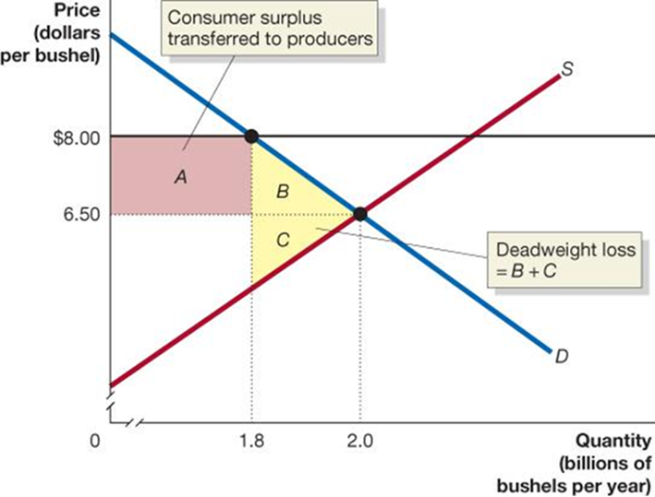
Figure 4.8 The Economic Effect of a Price Floor in the Wheat Market (1 of 2)
The equilibrium price in the market for wheat is $6.50 per bushel; 2.0 billion bushels are traded at this price.
If wheat farmers convince the government to impose a price floor of $8.00 per bushel, the quantity traded falls to 1.8 billion bushels.
Area A is the surplus transferred from consumers to producers.
Economic surplus is reduced by area B + C, the deadweight loss.
Notes:
The quantity of wheat in billions of bushels per year is on the x-axis. Price in dollars per bushel is on the y-axis. The x-axis has a break between 0 and the lowest number, which is 1.8. The y-axis has a break between 0 and the lowest number, which is 6.5. There is a horizontal curve at y = 8. The supply curve, S, starts at a point just above the break on the y-axis, and rises to the right. The demand line, D, starts at the top of the y-axis and falls to the right to the bottom corner of the graph. The supply and demand curves intersect at the point (2, 6.5). The demand curve intersects with the horizontal line at the point (1.8, 8). Both points are connected to the x and y-axis with dotted horizontal and vertical lines. The area to the left of the point of intersection of the horizontal line and demand curve and above the dotted horizontal line from the point of intersection of the S and D curves to the y-axis is A. This is the consumer surplus transferred to producers. The triangular space between the point at the intersection of the horizontal and demand curves, the point at the intersection of S and D, and the point at (1.8, 6.5) is B. The hypotenuse of this triangle is the stretch of the demand curve between the two points of intersection. The triangle underneath B shares a side and has the vertical curve at 1.8 as another side. The hypotenuse is the section of the supply curve between the point of intersection of S and D and the vertical curve at 1.8. This triangle is C. The deadweight loss = B + C.

Slide 26
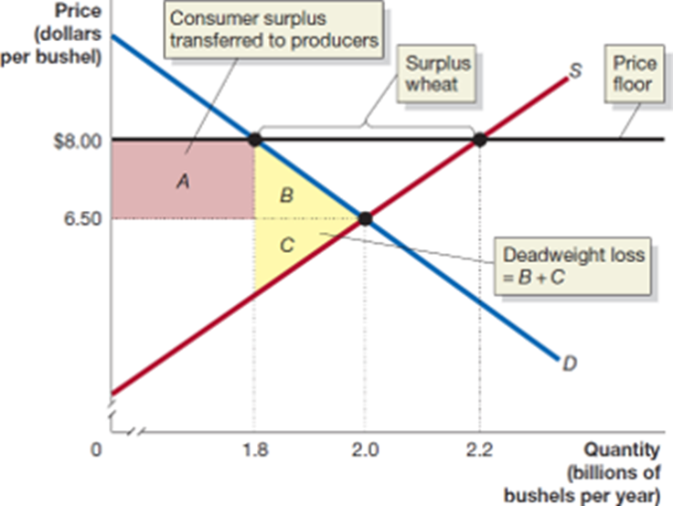
Figure 4.8 The Economic Effect of a Price Floor in the Wheat Market (2 of 2)
Unfortunately, the situation may be even worse:
If farmers do not realize they will not be able to sell all of their wheat, they will produce 2.2 billion bushels.
This results in a surplus, or excess supply, of 400 million bushels of wheat.
In practice, these surpluses are common and large.
Notes:
On the truncated graph, the X-axis represents quantity in billions of bushels per year, and the Y-axis represents price per dollars per bushel. The horizontal line across the graph at $.8.00 represents the price floor. The demand curve falls through the points (1.8, 8), and (2, 6.50). The supply curve rises through the points (2, 6.50), (2.2, 8). The curves intersect at (2, 6.50). The area to the left of the intersection within the interior angle is divided into parts, labeled, and color coded. Rectangle area A is red, and between (0, 8) (1.8, 8), (1.8, 6.50), and (0, 6.50). It represents consumer surplus transferred to producers. Area A shares a vertical side with triangle area B in yellow, which shares a side with area C and the demand curve between points (1.8, 8), and (2, 6.50). Triangle area C in yellow, shares a side with the supply curve and represents deadweight loss = B + C. The space between points (1.8, 8), and (2.2, 8) is the surplus wheat.

Slide 27
Price Floors in Labor Markets: The Debate Over Minimum Wage Policy
The minimum wage may be the most controversial ‘price floor’.
Supporters of the minimum wage see it as a way of raising the incomes of low-skilled workers.
Opponents argue that it results in fewer jobs and imposes large costs on small businesses.
The federal minimum wage has been $7.25 per hour since 2009, and many cities and states have minimum wages above the federal level.

Slide 28
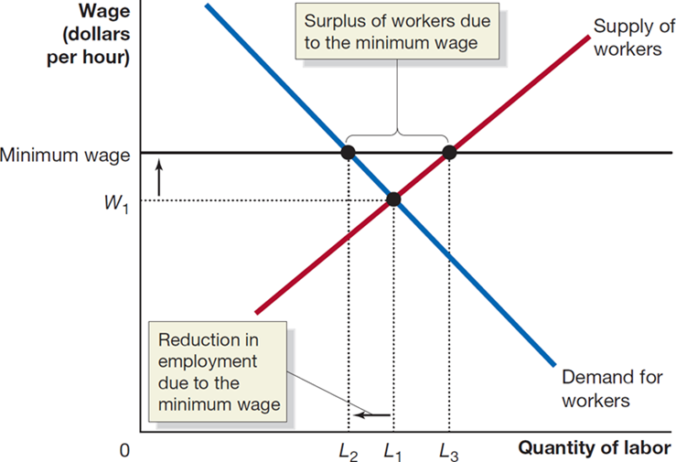
Figure 4.9 The Effect of a Minimum Wage on the Labor Market
Assuming the minimum wage does decrease employment, it must result in a deadweight loss for society.
How much of a decrease in employment occurs due to minimum wages, and are the benefits worth the costs?
Economists continue to debate this.
Notes:
The X-axis represents quantity of labor, and the Y-axis represents wage in dollars per hour. The demand for workers curve falls through points (L sub 2, minimum wage) and (L sub 1, W sub 1). The supply of workers curve rises through points (L sub 1, W sub 1) and (L sub 3, minimum wage). The distance between points (L sub 2, minimum wage) and (L sub 3, minimum wage) is the surplus of workers due to the minimum wage. The supply and demand curves intersect at (L sub 1, W sub 1). The distance between L sub 1 and L sub 2 is the reduction in employment due to the minimum wage.

Slide 29
Apply the Concept: Natural Experiments and the Minimum Wage (1 of 2)
We could find out the effects of minimum wages by running experiments: changing minimum wages in different places and observing the outcomes.
But this has both ethical and financial difficulties.
As an alternative, economists often look for natural experiments, where some variable of interest changes for one group of people but not for another similar group.

Slide 30
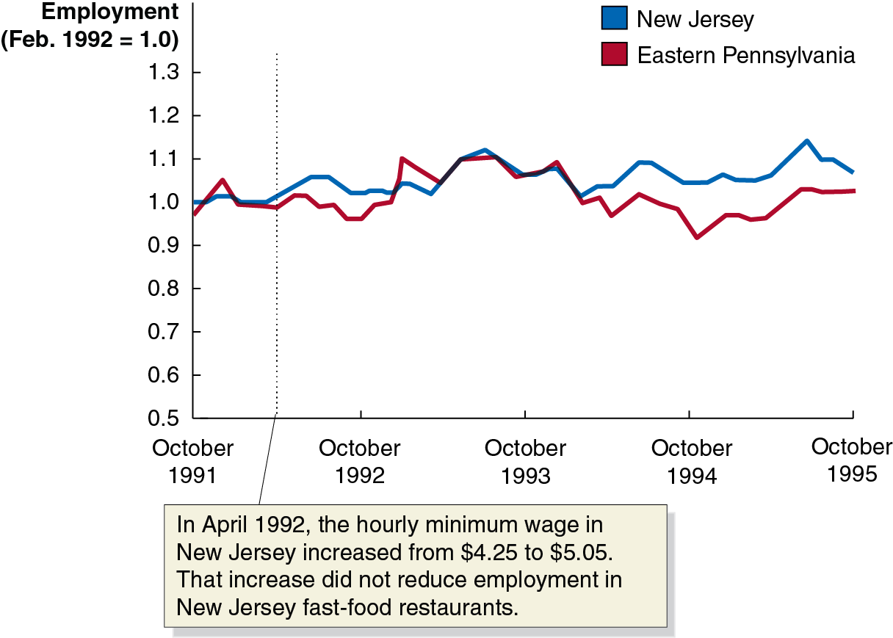
Apply the Concept: Natural Experiments and the Minimum Wage (2 of 2)
David Card and Alan Krueger compared employment in fast food restaurants in neighboring counties in New Jersey and Pennsylvania, after New Jersey raised its minimum wage.
Perhaps surprisingly, employment in New Jersey increased rather than decreased.
Notes:
The vertical axis plots the employment, February 1992 = 1.0, and ranges from 0.5 to 1.3 in increments of 0.1. The horizontal axis plots the time period from October 1991 to October 1995 in increments of 1 year. The graph plots two curves. The curve for New Jersey starts at (October 1991, 1.0), extends horizontally with minimal rise and fall passing through (October 1992, 1.02), (October 1993, 1.04), (October 1994, 1.04), and (October 1995, 1.05). The curve for Eastern Pennsylvania starts at (October 1991, 0.98), passes through (October 1992, 0.96), (October 1993, 1.04), (October 1994, 0.95), and (October 1995, 1.0). All values are estimated.

Slide 31
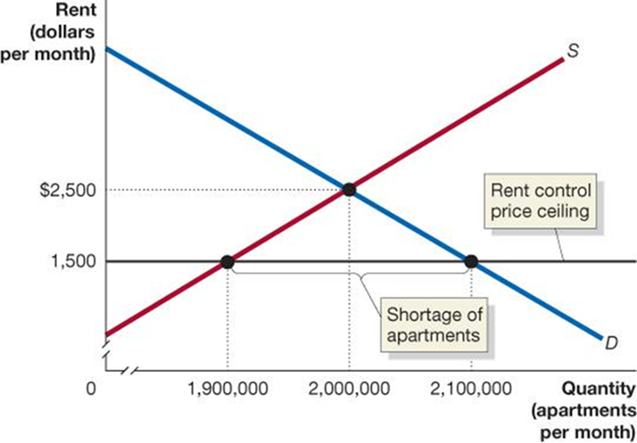
Figure 4.10 The Economic Effect of a Rent Ceiling (1 of 2)
Without rent control, the equilibrium rent is $2,500 per month.
At that price, 2,000,000 apartments would be rented.
If the government imposes a rent ceiling of $1,500:
The quantity of apartments supplied falls to 1,900,000.
The quantity of apartments demanded rises to 2,100,000.
This results in a shortage of 200,000 apartments.
Notes:
Quantity in apartments per month is on the x-axis, and rent in dollars per month is on the y-axis. The x-axis has a break between 0 and the lowest number, which is 1,900,000. The y-axis also has a break between 0 and the lowest number, which is 1,500. The S curve starts at (0, 500) and rises to the right to the top right corner of the graph. The D curve starts at (0, 5,000) and decreases to the bottom right corner of the graph. A horizontal line at 1,500 represents the rent control price ceiling. S and D intersect at point (2,000,000, 2500). The rent control curve intersects with S at (1,900,000, 1500), and with D at (2,100,000, 1,500). The length of the horizontal line between where it intersects with the S and D curves represents the shortage of apartments.

Slide 32
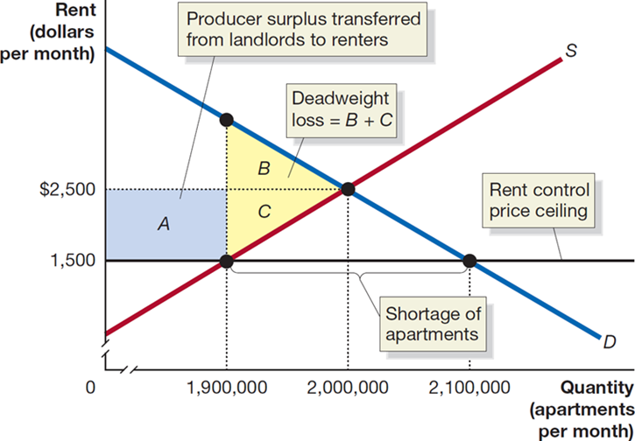
Figure 4.10 The Economic Effect of a Rent Ceiling (2 of 2)
Producer surplus equal to the area of the blue rectangle A is transferred from landlords to renters.
There is a deadweight loss equal to the areas of yellow triangles B and C.
This deadweight loss corresponds to the surplus that would have been derived from apartments that are no longer rented.
Notes:
On the truncated graph, the X-axis represents quantity in apartments per month, and the Y-axis represents rent in dollars per month. The horizontal line across the graph from 1,500 represents the rent control price ceiling. The demand curve falls through the points 1,900,000, (2,000,000, 2,500), and (2,100,000, 1,500). The supply curve rises through (1,900,000, 1,500) and (2,000,000, 2,500). The demand and supply curve intersect at (2,000,000, 2,500). The distance between points (1,900,000, 1,500) and (2,100,000, 1,500) are the shortage of apartments. To the left of the intersection of the supply and demand curves, rectangular area A is colored blue and falls between (0, 2,500), (0, 1,500), (1,900,000, 1,500) and (1,900,000, 2,500). It represents the producer surplus transferred from landlords to renters. Triangle B, in yellow, shares a side with areas A and triangle C, below it. It falls between the points 1,900,000, (2,000,000, 2,500), and (1,900,000, 1,500). Triangle C in yellow is a reflection of triangle B and shares the points (1,900,000, 1,500), (1,900,000, 2,500), and (2,000,000, 2,500). Deadweight loss = B + C.

Slide 33
Illegal Markets and Peer-to-Peer Sites
The shortage of apartments may lead to an illegal market—a market in which buying and selling take place at prices that violate government price regulations.
Alternatively, landlords might switch from long-term to short-term rentals in order to avoid rent controls; peer-to-peer rental sites such as Airbnb have facilitated this switch.
These markets may alleviate some of the deadweight loss by allowing additional apartments to be rented, but buyers and sellers lose valuable legal protections.

Slide 34
The Results of Government Price Controls
When a government imposes price controls:
Some people win (ex: renters with lower rents, or landlords who can exploit the shortage of housing to illegally raise rents),
Some people lose (ex: law-abiding landlords, and renters unable to find apartments), and
There is a loss of economic efficiency (ex: fewer apartments rented results in deadweight loss).

Slide 35
Apply the Concept: Should the Government Limit “Price Gouging” During an Emergency? (1 of 4)
In early 2020, as the Covid-19 pandemic spread through the United States, people flocked to supermarkets and pharmacies to buy hand sanitizer, disinfectant wipes, and toilet paper.
By March, these products had largely disappeared from store shelves. People who hoped to buy them on Amazon or eBay found that sellers were charging prices far above normal.
For instance, sellers on Amazon were charging $99.95 for large bottles of hand sanitizer that normally sell for $9.95.

Slide 36
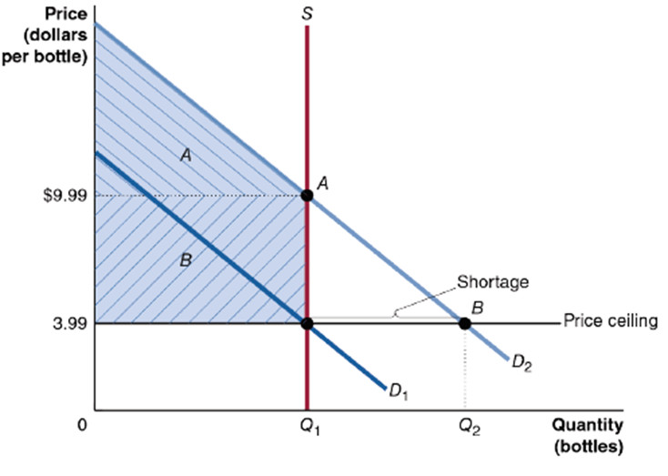
Apply the Concept: Should the Government Limit “Price Gouging” During an Emergency? (2 of 4)
Early in the Covid-19 pandemic, demand surged for products like hand sanitizer.
The graph shows the market for hand sanitizer in early 2020.
Demand increased, and in the very short run, supply was unable to change, driving prices up from $3.99 to $9.99.
Sellers of hand sanitizer gained, and only buyers willing to pay $9.99 or more could obtain hand sanitizer.
Notes:
A horizontal line marks a price ceiling at price = 3.99. Demand curve D sub 1 falls diagonally through (Q sub 1, 3.99). Demand curve D sub 2 is shifted up, falling through point B at (Q sub 2, 3.99). Supply curve S rises vertically, intersecting D sub 1 at (Q sub 1, 3.99) and D sub 2 at point A at (Q sub 1, 9.99). The area on the graph to the left of S and above the price ceiling is shaded. The area above price = 9.99 is A and the area below is B.

Slide 37
Apply the Concept: Should the Government Limit “Price Gouging” During an Emergency? (3 of 4)
Should the government have put a ceiling on the price of hand sanitizer?
If it did so,
Sellers would not gain the abnormally high profits,
There would be a shortage of hand sanitizer, but the price would not ration it to the people who are willing to pay the most for it.
Is this a better outcome?
Notes:
A horizontal line marks a price ceiling at price = 3.99. Demand curve D sub 1 falls diagonally through (Q sub 1, 3.99). Demand curve D sub 2 is shifted up, falling through point B at (Q sub 2, 3.99). Supply curve S rises vertically, intersecting D sub 1 at (Q sub 1, 3.99) and D sub 2 at point A at (Q sub 1, 9.99). The area on the graph to the left of S and above the price ceiling is shaded. The area above price = 9.99 is A and the area below is B.

Slide 38
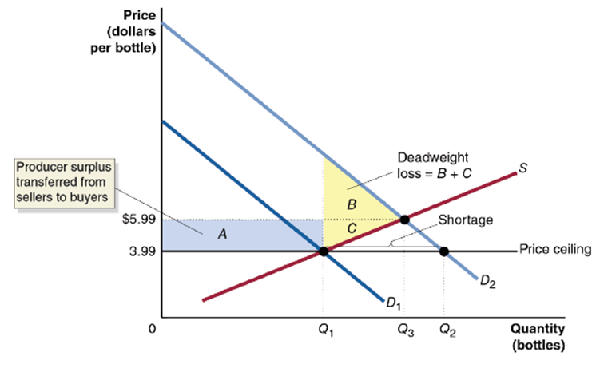
Apply the Concept: Should the Government Limit “Price Gouging” During an Emergency? (4 of 4)
In the medium run, suppliers will adjust to the higher demand for hand sanitizer and produce more units.
Marginal costs will increase, as firms pay overtime to workers and convert factories to sanitizer production.
A price gouging law would have kept supply from increasing, as the additional costs could not be justified by the firms.
Notes:
A horizontal line representing a price ceiling is marked at price = 3.99. Three quantities are marked on the x axis from left to right, Q sub 1, Q sub 3, and Q sub 2. Demand curve D sub 1 falls diagonally through point (Q sub 1, 3.99). Demand curve D sub 2 is shifted up, falling through (Q sub 2, 3.99). Supply curve S rises diagonally, intersecting D sub 1 at (Q sub 1, 3.99) and D sub 2 at (Q sub 3, 5.99). The area on the graph between quantities 0 and Q sub 1 and prices 3.99 and 5.99 is shaded, representing A. The area between the supply curve and D sub 2 to the right of Q sub 1 is shaded. The area above price = 5.99 is B and the area below is C.

Slide 39
Positive and Normative Analysis of Price Ceilings and Price Floors
Economic analysis can demonstrate that price ceilings and price floors decrease economic efficiency. Does this mean they are bad?
Because this is a normative question, it does not have a right or wrong answer; it depends on our values and judgments. It is possible to value the gains from these policies more than the losses.

Slide 40
4.4 The Economic Effect of Taxes
Analyze the economic effect of taxes.
Taxes are the most important method by which governments fund their activities.
We will concentrate on per-unit taxes: taxes assessed as a particular dollar amount on the sale of a good or service, as opposed to a percentage tax.
Example: The U. S. Federal government imposes an excise tax of 18.4 cents per gallon of gasoline as of 2023.

Slide 41
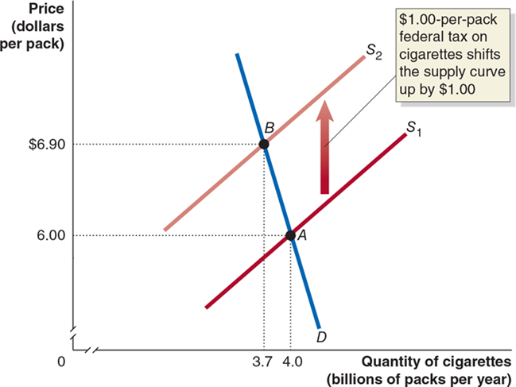
Figure 4.11 The Effect of a Tax on the Market for Cigarettes (1 of 4)
Without the tax, market equilibrium occurs at point A.
The equilibrium price of cigarettes is $6.00 per pack, and 4 billion packs of cigarettes are sold per year.
A $1.00-per-pack tax on cigarettes will cause the supply curve for cigarettes to shift up by $1.00, from
Notes:
A graph plots price in dollars per pack versus quantity of cigarettes, in billions of packs per year. The demand curve, D, starts near (3.5, 7.2) and falls sharply and diagonally to the right to (4.1, 0). S1 starts near (3.5, 1) and rises diagonally to the right to end in the upper right corner of the x-y plane. S1 intersects with D at point A, which is at (4, 6). Curve S2 starts near (3, 6) and rises diagonally to the right at a set distance above curve S1, ending in the upper right corner of the x y plane. The intersection of S2 and D is at point B, which is at (3.7, 6.9). A vertical arrow leads from S1 to S2. A text inset reads, 1 dollar-per-pack federal tax on cigarettes shifts the supply curve up by one dollar.

Slide 42

Figure 4.11 The Effect of a Tax on the Market for Cigarettes (2 of 4)
The supply curve shifted up by $1.00, the amount of the tax.
If firms were willing to sell 4 billion packs at a price of $6.00 before the tax, the price needs to be exactly $1.00 higher in order to convince them to still sell 4 billion packs.
This is because firms’ marginal costs effectively increased by $1.00 per unit, the value of the tax.
Notes:
The graph plots price in dollars per pack versus quantity of cigarettes, in billions of packs per year. The demand curve, D, starts near (3.5, 7.2) and falls sharply and diagonally to the right to (4.1, 0). S1 starts near (3.5, 1) and rises diagonally to the right to end in the upper right corner of the x y plane. S1 intersects with D at point A, which is at (4, 6). Curve S2 starts near (3, 6) and rises diagonally to the right at a set distance above curve S1, ending in the upper right corner of the x y plane. The intersection of S2 and D is at point B, which is at (3.7, 6.9). A vertical arrow leads from S1 to S2. A text inset reads, 1 dollar-per-pack federal tax on cigarettes shifts the supply curve up by one dollar.

Slide 43
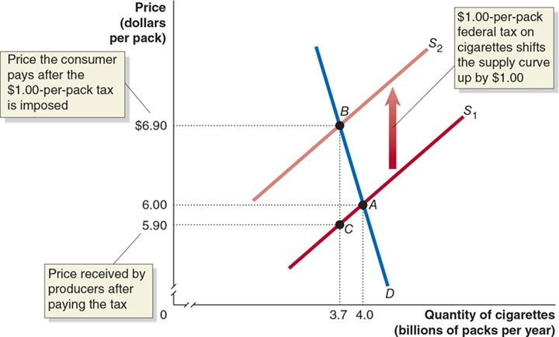
Figure 4.11 The Effect of a Tax on the Market for Cigarettes (3 of 4)
The new equilibrium occurs at point B; the quantity sold falls to 3.7 billion packs.
The tax increases the price paid by consumers to $6.90 per pack.
Producers receive a price of $6.90 per pack (point B), but after paying the $1.00 tax, they are left with $5.90 (point C).
Notes:
The graph plots price in dollars per pack versus quantity of cigarettes, in billions of packs per year. The demand curve, D, starts near (3.5, 7.2) and falls sharply and diagonally to the right to (4.1, 0). S 1 starts near (3.5, 1) and rises diagonally to the right to end in the upper right corner of the x y plane. S1 intersects with D at point A, which is at (4, 6). Curve S2 starts near (3, 6) and rises diagonally to the right at a set distance above curve S1, ending in the upper right corner of the x y plane. The intersection of S2 and D is at point B, which is at (3.7, 6.9). A vertical arrow leads from S1 to S2. A text inset reads, 1 dollar per pack federal tax on cigarettes shifts the supply curve up by one dollar. Point C is on the S1 line at (3.7, 5.9). Y = 5.9 is the price received by producers after paying the tax. Y = 6.9 is the price the consumer pays after the one dollar per pack tax is imposed.

Slide 44
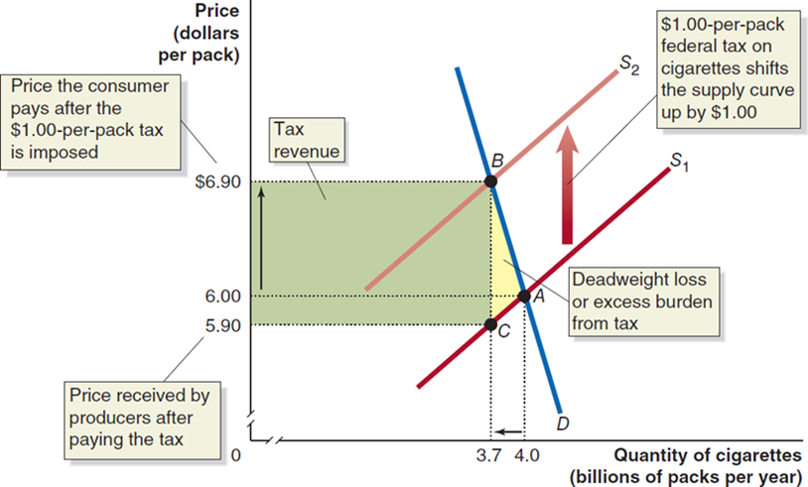
Figure 4.11 The Effect of a Tax on the Market for Cigarettes (4 of 4)
The government will receive tax revenue equal to the green shaded box.
Some consumer surplus and some producer surplus will become tax revenue for the government, and some will become deadweight loss, shown by the yellow-shaded area.
Notes:
The graph plots price in dollars per pack versus quantity of cigarettes, in billions of packs per year. The demand curve, D, starts near (3.5, 7.2) and falls sharply and diagonally to the right to (4.1, 0). S1 starts near (3.5, 1) and rises diagonally to the right to end in the upper right corner of the x y plane. S1 intersects with D at point A, which is at (4, 6). Curve S2 starts near (3, 6) and rises diagonally to the right at a set distance above curve S1, ending in the upper right corner of the x y plane. The intersection of S2 and D is at point B, which is at (3.7, 6.9). A vertical arrow leads from S1 to S2. A text inset reads, 1 dollar-per-pack federal tax on cigarettes shifts the supply curve up by one dollar. Point C is on the S1 line at (3.7, 5.9). Y = 5.9 is the price received by producers after paying the tax. Y = 6.9 is the price the consumer pays after the 1- dollar-per-pack tax is imposed.

Slide 45
What Makes One Tax Better Than Another?
In the “public finance” literature, economists refer to the deadweight loss from a tax as its excess burden.
Given that we want to raise tax revenue, what makes one tax preferred over another?
A tax is efficient if it imposes a small excess burden relative to the tax revenue it raises.
Economists can advise policymakers about which taxes are the most efficient.

Slide 46
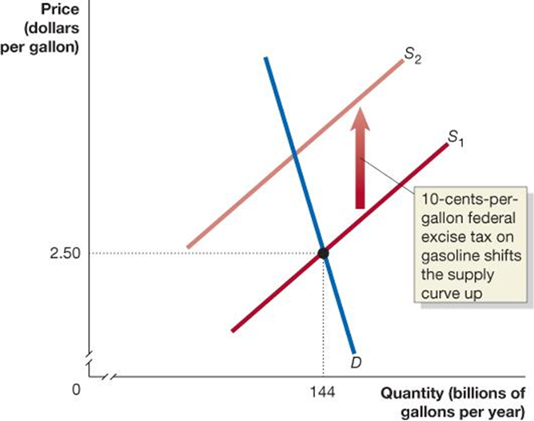
Figure 4.12 The Incidence of a Tax on Gasoline (1 of 2)
With no tax on gasoline, the price would be $2.50 per gallon, and 144 billion gallons of gasoline would be sold each year.
A 10-cents-per-gallon excise tax shifts up the supply curve from
Notes:
On the truncated graph, the horizontal axis represents quantity in billions of gallons per year, and the vertical axis represents price in dollars per gallon. Supply line S sub 1 rises through the point (144, 2.50). The line shifts up, when 10 cents per gallon federal excise tax on gasoline shifts the supply curve up, and becomes line S sub 2. The demand line falls diagonally and intersects the supply lines at point (144, 2.50).

Slide 47
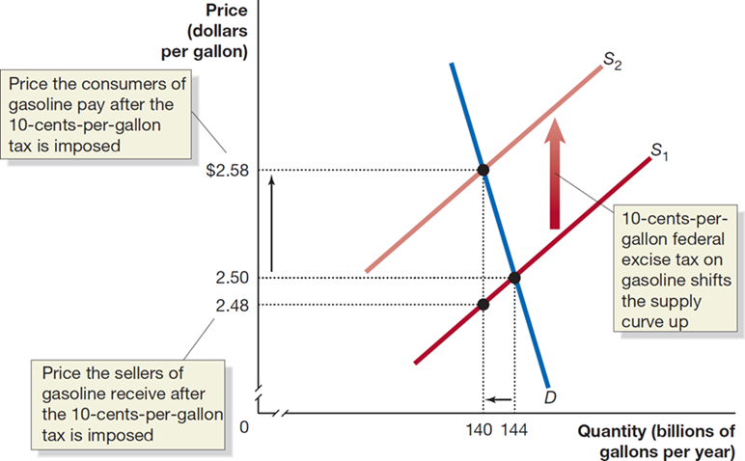
Figure 4.12 The Incidence of a Tax on Gasoline (2 of 2)
The price consumers pay rises from $2.50 to $2.58.
The price sellers receive falls from $2.50 to $2.48.
Therefore, consumers pay 8 cents of the 10-cents-per-gallon tax on gasoline, and sellers pay 2 cents.
Notes:
On the truncated graph, the X-axis represents quantity in billions of gallons per year, and the Y-axis represents Price in dollars per gallon. $2.58 represents the price the consumers of gasoline pay after the 10-cents-per-gallon tax is imposed. $2.48 represents the price the sellers of gasoline receive after the 10-cents-per-gallon tax is imposed. Supply curve S sub 1 rises through the points (140, 2.48), and (144, 2.50). The curve shifts up, when 10-cents-per-gallon federal excise tax on gasoline shifts the supply curve up, and becomes curve S sub 2. The demand curve falls through the points (140, 2.58), and (144, 2.50).

Slide 48
Tax Incidence: Who Actually Pays a Tax?
In the market for gasoline, the buyers effectively paid 80% of the 10-cent-per-gallon tax, and the sellers paid 20%.
This is referred to as the tax incidence: the actual division of the burden of a tax between buyers and sellers in a market.
What determines this tax incidence?
Important observation: not “whoever has the legal obligation to pay the tax”…

Slide 49
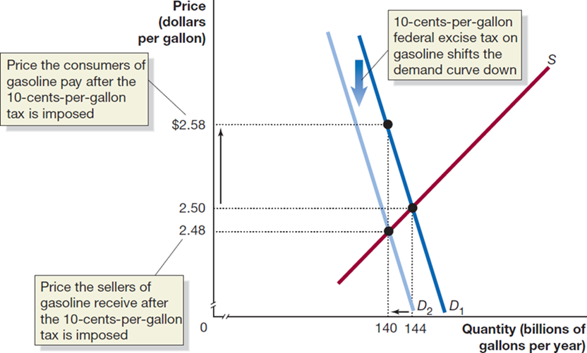
Figure 4.13 The Incidence of a Tax on Gasoline Paid by Buyers
If buyers have the legal obligation to pay the 10-cent-tax on gasoline, the price they pay, the price sellers receive, and the quantity traded all remain the same.
The tax incidence does not depend on who has the legal obligation to pay the tax.
Notes:
On the truncated graph, the X-axis represents quantity in billions of gallons per year, and the Y-axis represents price in dollars per gallon. $2.58 is the price the consumers of gasoline pay after the 10-cents-per-gallon tax is imposed. 2.48 is the price the sellers of gasoline receive after the 10-cents-per-gallon tax is imposed. Demand curve D sub 1 falls through the points (140, 2.58), and (144, 2.50), before shifting left, where the 10-cents-per-gallon federal excise tax on gasoline shifts the demand curve down, and becomes curve D sub 2. D sub 2 falls through point (140, 2.48). The supply curve rises through the graph, intersecting the demand curves at (140, 2.48), and (144, 2.50).

Slide 50
What Determines the Tax Incidence?
The incidence of the tax is determined by the relative slopes of the demand and supply curves.
A steep demand curve means that buyers do not change how much they buy when the price changes; this results in them taking on much of the burden of the tax.
A shallow demand curve means that buyers change how much they buy a lot when the price changes. Then they could not be forced to accept as much of the burden of the tax.
Similar analysis applies for sellers.

Slide 51
Apply the Concept: The Burden of the Social Security Tax (1 of 2)
The Federal Insurance Contributions Act (F I C A) tax is 15.3 percent of wages and funds Social Security and Medicare. By law, employers pay half (7.65 percent), as do workers.
Who really ends up with most of the burden of this tax?
The answer depends on who is less sensitive to changes in wages: employers (buyers of labor) or workers (sellers of labor).
Workers are relatively insensitive to their wages; that is, they don’t change their hours-of-work decision much when their wages change.
So, workers end up with most of the burden of this tax.

Slide 52
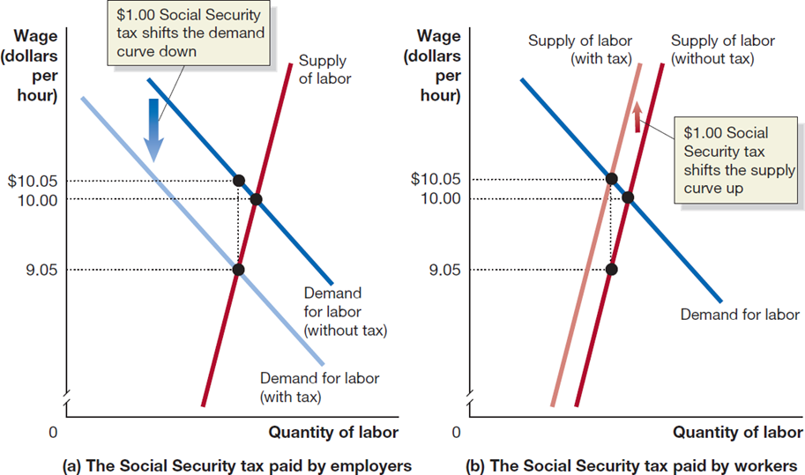
Apply the Concept: The Burden of the Social Security Tax (2 of 2)
The panels illustrate an imaginary $1.00 per hour Social Security tax.
Whether firms or workers have the legal obligation to pay the tax, workers end up with most of the tax burden.
Notes:
On both graphs, the X-axis represents quantity of labor, and the truncated Y-axis represents wage in dollars per hour. In panel (a), the social security tax is paid by the employer. The curve for demand for labor without tax shifts down when $1.00 social security tax shifts the demand curve down. The supply of labor curve intersects the demand curve at 9.05 and 10.00.
In panel (b), the social security tax is paid by workers. The supply of labor without tax curve shifts when $1.00 social security tax shifts the supply curve u, and becomes the supply of labor with tax curve. The demand for labor curve intersects the supply curves at 10.00 and 10.05.

Slide 53
Appendix: Quantitative Demand and Supply Analysis
Use quantitative demand and supply analysis.
Suppose that the demand for apartments in New York City is
and the supply of apartments is:
In equilibrium, we know:
(This is known as the equilibrium condition.)

Slide 54
Solving for the Equilibrium Rent and Quantity
We use these to find the equilibrium rent and quantity:

Slide 55
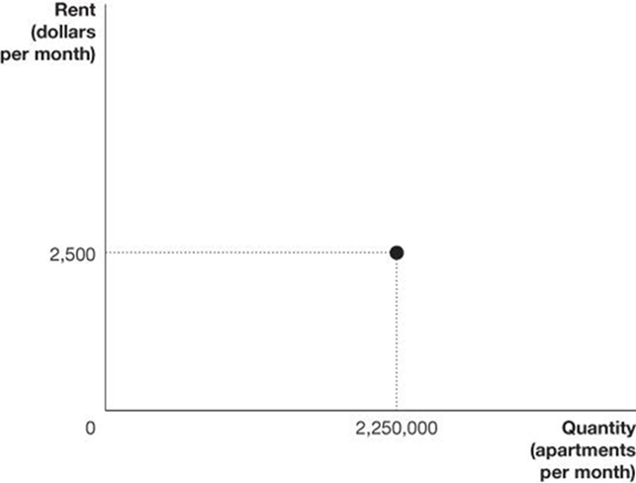
Figure 4A.1 Graphing Demand and Supply Equations (1 of 3)
Find the equilibrium quantity of apartments rented:
Or
We have found the equilibrium price and quantity; we can insert this on a demand and supply graph.

Slide 56
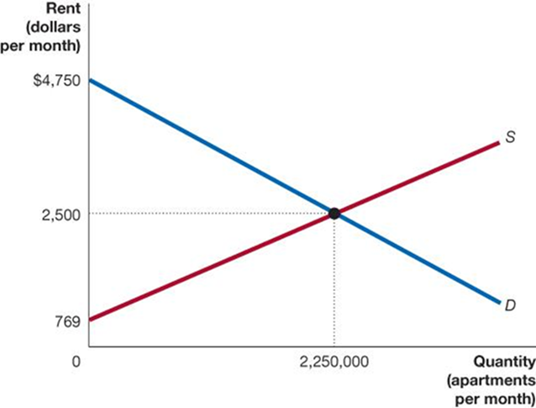
Figure 4A.1 Graphing Demand and Supply Equations (2 of 3)
To complete the graph, let’s find the y-intercepts of the demand and supply curves, by setting:
equal to zero:
Notes:
The quantity of apartments per month is plotted versus the rent in dollars per month. Curve S starts at (0, 769) and rises to the upper right middle of the graph. Curve D starts at (0, 4750) and falls to the right to the bottom right corner of the graph. The point where S and D intersect is (2,250,000, 2500).

Slide 57
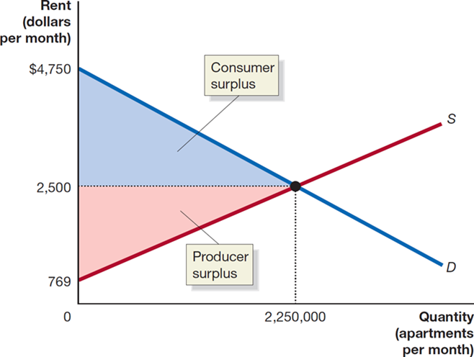
Figure 4A.1 Graphing Demand and Supply Equations (3 of 3)
Now we can calculate the estimated consumer and producer surplus, using the triangle area formula:
Notes:
The X-axis represents quantity in apartments per month, and the Y-axis represents the rent in dollars per month. The supply curve rises and the demand curve falls through the graph, intersecting at (2,500,000, 2,500). The space within the interior angle from the intersection of the curves is divided into 2 triangular parts. The top triangle is colored blue and between (0, 2,500), (2,250,000, 2,500), and (0, 4,750). The bottom triangle is colored red and between (0, 2,500), (2,500,000, 2,500), and (0, 769).

Slide 58
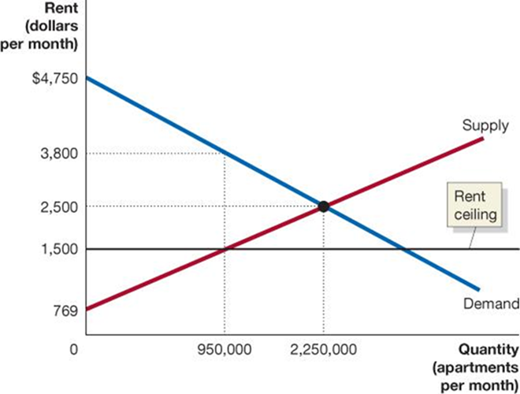
Figure 4A.2 Calculating the Economic Effect of Rent Controls (1 of 4)
Suppose the city imposes a rent ceiling of $1,500 per month. Calculate the quantity of apartments that will be rented:
Find the price on the demand curve when the quantity of apartments is 950,000:
Notes:
The quantity of apartments per month is plotted versus the rent in dollars per month. The supply curve starts at (0, 769) and rises to the upper right middle of the graph. The demand curve starts at (0, 4750) and falls to the right to the bottom right corner of the graph. The point where supply and demand intersect is (2,250,000, 2500). There is a horizontal line at y = 1,500, which is the rent ceiling. There is a dotted vertical line extending up from x = 950,000 through the intersection of the supply curve and the horizontal line to the demand curve. The point where it meets the demand curve is (950,000, 3800).

Slide 59
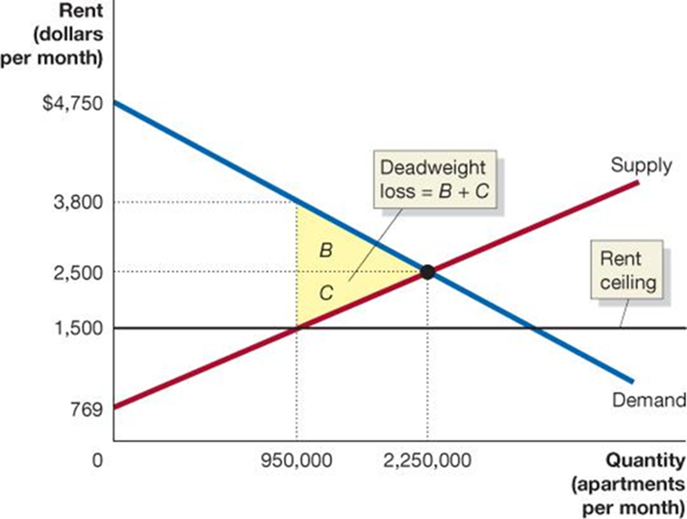
Figure 4A.2 Calculating the Economic Effect of Rent Controls (2 of 4)
Now the graph can guide our numerical estimates of the economic effects of the rent controls.
Triangles B + C represent the deadweight loss. Area B is:
Area C is:
So, the deadweight loss is 845 + 650 = $1,495 million.
Notes:
The quantity of apartments per month is plotted versus the rent in dollars per month. The supply curve starts at (0, 769) and rises to the upper right corner of the graph. The demand curve starts at (0, 4750) and falls to the bottom right corner of the graph. The point where supply and demand intersect is (2,250,000 , 2500). There is a horizontal line at y = 1,500, which is the rent ceiling. There is a dotted vertical line extending up from x = 950,000 through the intersection of the supply curve and the horizontal line to the demand curve. The point where it meets the demand curve is (950,000 , 3800). The triangular area between the points (950,000 , 3800), (2,250,000 , 2500), and (950,000 , 2500) is B. The triangular area between the points (950,000 , 2500), (2,250,000 , 2500), and (950,000 , 1500) is C. Deadweight loss = B + C.

Slide 60
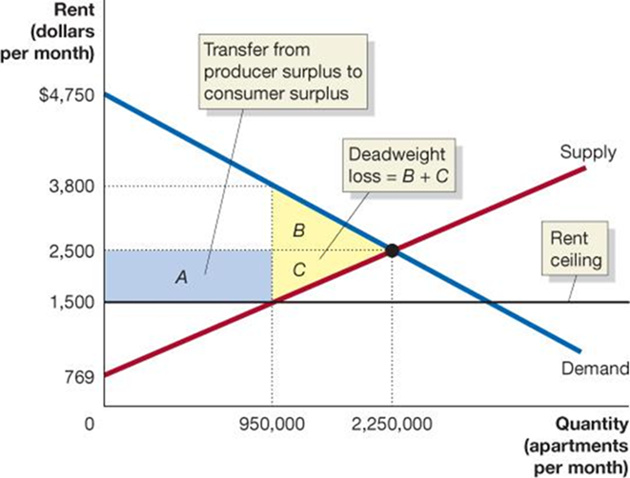
Figure 4A.2 Calculating the Economic Effect of Rent Controls (3 of 4)
Consumers lose area B ($845 million) but gain the area of rectangle A:
So, consumer surplus changes from $2,531.25 million to:
Notes:
The quantity of apartments per month is plotted versus the rent in dollars per month. The supply curve starts at (0, 769) and rises to the upper right middle of the graph. The demand curve starts at (0, 4750) and falls to the right to the bottom right corner of the graph. The point where supply and demand intersect is (2,250,000 , 2500). There is a horizontal line at y = 1,500, which is the rent ceiling. There is a dotted vertical line extending up from x = 950,000 through the intersection of the supply curve and the horizontal line to the demand curve. The point where it meets the demand curve is (950,000 , 3800). The triangular area between the points (950,000 , 3800), (2,250,000 , 2500), and (950,000 , 2500) is B. The triangular area between the points (950,000 , 2500), (2,250,000 , 2500), and (950,000 , 1500) is C. Deadweight loss = B + C. The rectangular area above the horizontal line at 1,500, below a dotted horizontal line at 2,500, and to the left of triangle C is A. This is the transfer from producer surplus to consumer surplus.

Slide 61
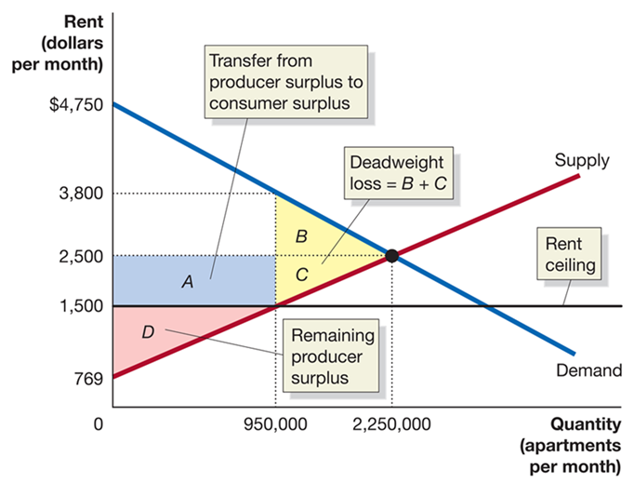
Figure 4A.2 Calculating the Economic Effect of Rent Controls (4 of 4)
Producers lose area A ($950 million) and area C ($650 million); they originally had a surplus of $1,947.375 million, so now the producer surplus is:
Notes:
The X-axis represents quantity in apartments per month, and the Y-axis represents the rent in dollars per month. The horizontal line across the graph from 1,500 is the rent ceiling. The supply curve rises and the demand curve falls through the graph, intersecting at (2,500,000, 2,500). Within the interior angle of the intersecting curves, part A in blue between (0, 2,500), (950,000, 2,500), (950,000, 1,500), and (0, 1,500), and is the transfer from producer surplus to consumer surplus. Triangle B between (950,000, 2,500), (950,000, 3,800), (2,250,000, 2,500), and triangle C between (950,000, 1,500), (2,250,000, 2,500), and (950,000, 2,500) are both yellow. Deadweight loss = B + C. Triangle D in red between (0, 1,500), (950,000, 1,500), and (0, 769), and makes up remaining producer surplus.

Slide 62
Summary of Computations
The following table summarizes the results of the analysis (the values are in millions of dollars):
Consumer Surplus
Producer Surplus
Deadweight Loss
Competitive Equilibrium | Rent Control
$ 2,531 | $ 2,636
Competitive Equilibrium | Rent Control
$ 1,947 | $ 347
Competitive Equilibrium | Rent Control
$ 0 | $ 1,495

Slide 63

Copyright
This work is protected by United States copyright laws and is provided solely for the use of instructors in teaching their courses and assessing student learning. Dissemination or sale of any part of this work (including on the World Wide Web) will destroy the integrity of the work and is not permitted. The work and materials from it should never be made available to students except by instructors using the accompanying text in their classes. All recipients of this work are expected to abide by these restrictions and to honor the intended pedagogical purposes and the needs of other instructors who rely on these materials.

